Slide 1
How could a 4-day week help Sussex workers thrive?
Dr Charlotte Rae
c.rae@sussex.ac.uk
@NeuroRae
Notes:
Hi everyone, so pleased to be here to talk about how a 4 day week might help Sussex workers thrive.

Slide 2
What is a 4-day week?
Full-time employees shorten their time at work to 4 days,
…with no loss of pay
Previous trials suggest that staff perform better in their jobs, despite less time to do them
Linked to enhanced motivation and wellbeing
Notes:
Let’s start by defining what we mean by this phrase, ‘a 4 day week’ – it’s been in the media a lot, so you may have come across this, but in a nutshell, a 4 day week is one in which full-time employees shorten their time at work to 4 days, but, with no loss of salary.
And why on earth would an employer do that?! Well what’s interesting is that the trials so far suggest despite staff having less time to do their jobs, they actually perform better in the workplace.
The reasons for that still aren’t entirely clear, but we think it’s because they’ve got higher motivation, and better wellbeing in their own lives.

Slide 3
What are the potential benefits?
Employers
Enhanced productivity, attitudes to work, team work, creativity
Fewer sick days
Improved retention
Boost recruitment
Workers
Better work-life balance
Lower stress & higher wellbeing
Higher motivation & job satisfaction
Notes:
These previous trials have shown a number of benefits, both for the employer, in that they see higher productivity, better attitudes to work, better team work, and more creativity, as well as less absenteeism, fewer people leaving, and better recruitment; but there are also benefits for the workers themselves, who have better work-life balance, better wellbeing, and just enjoy doing their jobs more.

Slide 4
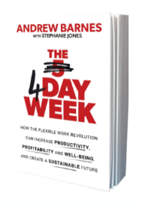
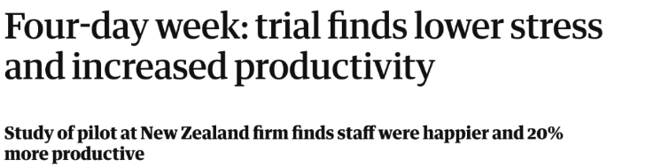
Perpetual Guardian trial
Notes:
We know about these results because of trials conducted in real businesses. A couple of years ago, Andrew Barnes conducted a trial of the 4 day week in his own business, and he was so impressed with the results, he wrote a book on it. Here’s some of his findings:

Slide 5
Perpetual Guardian trial
Notes:
Firstly, he saw that work-life balance and employee wellbeing really increased, we think this is happening because workers have basically got more time to look after themselves and recharge away from work, potentially helping improve both their physical and mental health.

Slide 6
Perpetual Guardian trial
Notes:
It’s interesting what that translates to in the workplace. Andrew saw that in a given day, his team was 20% more productive, so overall, across the working week, that meant they managed to get the same amount of work done in only 4 days. And employees reported higher job satisfaction, higher work engagement – that’s how enthusiastic they feel about the job – and increased intention to stay with the company.

Slide 7
Perpetual Guardian trial
Notes:
Andrew also saw that team work improved, and his staff were more creative in their jobs as well.

Slide 8




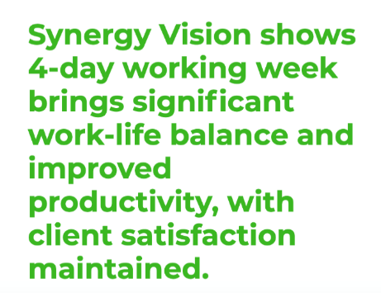
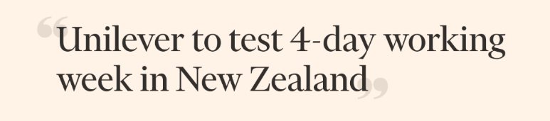

Organisations with a 4-day week
1 year…still ongoing!
Notes:
This isn’t the only trial, over the last couple of years we’ve seen lots of headlines from around the world, with other businesses pretty much finding similar things, that there are improvements both in workplace function, and in employee wellbeing too.

Slide 9
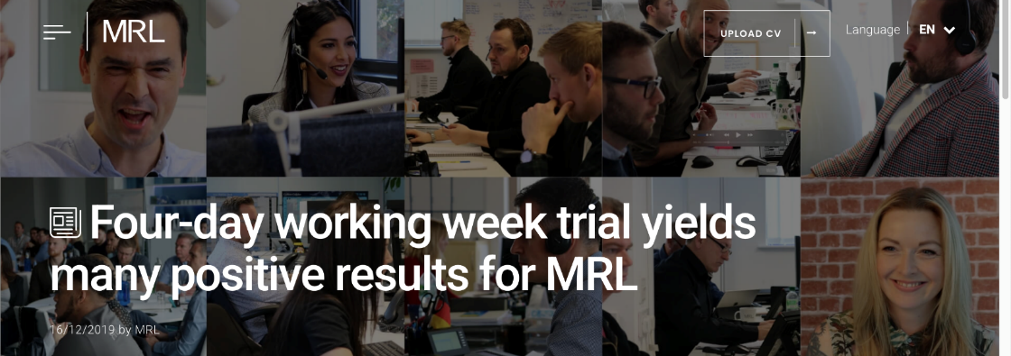
Organisations with a 4-day week
Productivity rose 25%
87% reported ‘marked improvement in mental health'
Now permanent 4-day week for all staff
Notes:
Here’s our local success story, MRL recruitment in Hove, who trialled a 4 day week a couple of years back, and it was such a success, they decided to adopt it longer term.

Slide 10
Why aren’t we all working 4 days?
Notes:
So why aren’t we all working 4 days?!
I was at an event with Brighton Chamber of Commerce last week, and there was quite a strong consensus in the room that on paper, the 4 day week sounded like a good thing, a great aspiration, but then when it comes to the nitty gritty of actually implementing it, there could be really quite a lot of challenges.

Slide 11
Why aren’t we all working 4 days?
Aspiration, versus reality! How to actually implement?
‘Is it fair on
staff currently
working part-time?’
‘How do we get same
amount work done
in less time?’
‘How can we afford
to give everyone
a pay rise?’
‘What if everyone
is off on the same day?’
‘How do we know
if it’s a success?’
Notes:
These were some of the questions coming up, “how do we get the same amount of work done in less time?”, for customer service industries, “what if everyone’s off on the same day, who answers the phone?”, “what about staff who are working part-time, is it fair on them?”, and for some sectors, real worries around “how can we afford to, essentially, give everyone a pay rise?” because I think its fair to say, many of the trials so far have been done in knowledge economy businesses, and here it makes sense that one could potentially increase productivity by working smarter, not harder. But let’s take social care, which is a big employer locally, that’s maybe more of a challenge – because you can’t reasonably expect an increase in care given with fewer hours! So you’d be talking about essentially giving everyone a pay rise in that they’d do less work for the same money. What some social care businesses have found, however, is that they have a lot of recruitment costs, because turnover is so high – and there are a couple of examples from the States where they actually made a 4 day week work, because no one left, and so their drop in recruitment costs offset the staff salaries. It would be really useful to know if this translates on the ground here in Sussex.

Slide 12

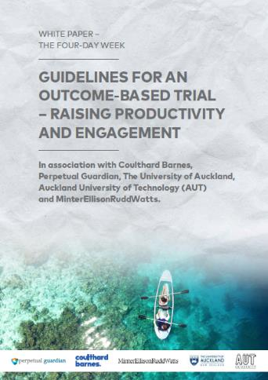
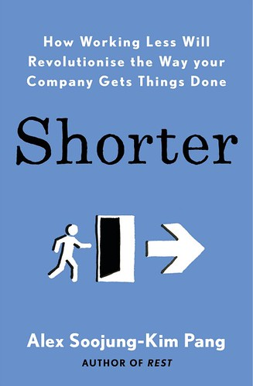

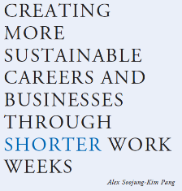
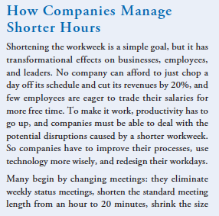
Why aren’t we all working 4 days?
Aspiration, versus reality! How to actually implement?
Notes:
It can feel like a really big risk to do a 4 day week when there are all these unknown questions, and I think that’s where looking to the previous trials can be helpful for advice and guidance, these are some books and guidelines from those who’ve been there, done that, tried it out,

Slide 13
Why aren’t we all working 4 days?
Aspiration, versus reality! How to actually implement?
‘How do we get same
amount work done
in less time?’
Notes:
I’ll just briefly summarise how they addressed these questions,
Firstly in a knowledge economy type business, you can get more done by tips and tricks such shortening meetings, reducing distractions such as keeping email open when you need to be focusing on a demanding task.

Slide 14
Why aren’t we all working 4 days?
Aspiration, versus reality! How to actually implement?
‘How do we get same
amount work done
in less time?’
‘What if everyone
is off on the same day?’
Notes:
As to which day employees have off, well you can tailor this for the business, MRL in Hove decided to just entirely close on Fridays, but if it’s a customer service business, you can dovetail, so one person’s off on a Monday, another on Tuesday, etc.

Slide 15
Why aren’t we all working 4 days?
Aspiration, versus reality! How to actually implement?
‘Is it fair on
staff currently
working part-time?’
‘How do we get same
amount work done
in less time?’
‘What if everyone
is off on the same day?’
Notes:
For the part-time issue, one can either give part-time staff a pay rise, in that they’re now working, quotes, “full time”, or you can keep their salary as it is, but give them a corresponding reduction in time at work – but with the proviso that workplace performance remains strong.

Slide 16
Why aren’t we all working 4 days?
Aspiration, versus reality! How to actually implement?
‘Is it fair on
staff currently
working part-time?’
‘How do we get same
amount work done
in less time?’
‘How can we afford
to give everyone
a pay rise?’
‘What if everyone
is off on the same day?’
Notes:
And finally, the financial aspect is going to be different for different sectors, but one way to find out if its feasible is to do a trial.

Slide 17
Why aren’t we all working 4 days?
Aspiration, versus reality! How to actually implement?
‘Is it fair on
staff currently
working part-time?’
‘How do we get same
amount work done
in less time?’
‘How can we afford
to give everyone
a pay rise?’
‘What if everyone
is off on the same day?’
‘How do we know
if it’s a success?’
Notes:
That’s how you’ll know if it’s a success or not, or if its completely unworkable for your organization, by trying it out!

Slide 18
The Sussex 4-day week study
12 week trial
(+ baseline monitoring)
Category | Measures
Workplace function | Occupational psychology measures
 | Measures decided by organisation
Wellbeing & lifestyle | Wellbeing questionnaires
 | Sleep, diet, exercise
Psychology & biology | MRI brain scan
 | Blood sample
Notes:
This is where we’re hoping we can be of use, as academics, I’m really excited we’re starting a new project next year to help support local businesses pilot a 4 day week, through us helping to monitor what’s changing, both in the workplace context, and for workers, in terms of their own wellbeing and health.

Slide 19
Aims
Help local businesses pilot – then make informed decision
Explain why a 4-day week can be effective (science)
Find out how a 4-day week could help Sussex economy
Notes:
The aims really are three-fold. Firstly, we want to help local businesses run a pilot, so that they’ve then got the data they need on what’s worked, and what hasn’t, to make an informed decision longer term.
Secondly we want to try and help explain why a 4 day week could be effective, from a scientific angle on how the mind works, and how workers being healthier and happier might be driving the workplace benefits.
And thirdly we want to help on a wider scale, by finding out how this works in reality in Sussex, and what potential a 4 day week has, or doesn’t have, for the local economy!

Slide 20
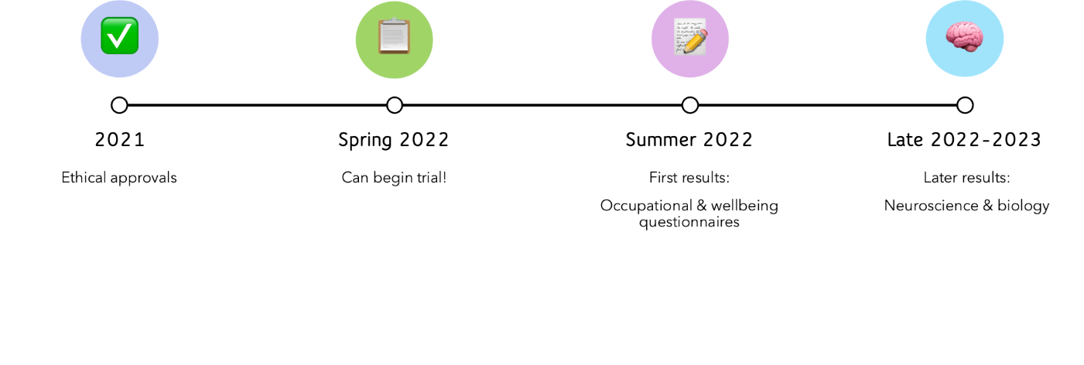
Project timeline
Notes:
We’re starting the study next year, so I hope to be able to report back maybe in next year’s Assembly on what we’ve found, but in the meantime, if anyone is interested in potentially piloting a 4 day week in their own organization, do get in touch with me, to see how we can support you in that.

Slide 21
Summary
A 4-day week can potentially help both employers, and employees
Each organisation probably needs custom implementation
(e.g. what day employees have off)
Trials can help find out what works, and what doesn’t!
…and how big the benefits are (or aren’t)
Notes:
Just to summarise,
A 4 day week can potentially help both employers, and employees, but each organization probably needs to implement it differently according to their own unique circumstances, and this is where doing a trial can help, to find out what works, and what doesn’t, and to quantify how big the benefits might be, or even if there aren’t any – but a trial can help confirm that one way or the other.

Slide 22
Discussion questions
Are you interested in potentially implementing a 4-day week in your own organisation?
What might be the pros and cons?
What barriers might there be? What help would you need to overcome these?
Do you think a 4-day week really could help Sussex organisations and workers thrive?
Notes:
Here are the suggested discussion points to take into the breakout rooms, I think Harriet is also posting these in the chat.

Slide 23
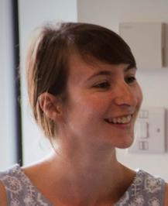







Thank you
Research team
Graham Peters
Dr Charlotte Rae
Joanna McLaren
…you!
Prof Tom Ormerod
Prof Sarah Garfinkel
Dr Jessica Eccles
Dr Emma Russell
Kate Thorpe
Notes:
I’ll end by thanking the other members of the research team, and Graham Peters for inviting me, and thanks for your attention

