Slide 1
Smarter, Faster, Together
Graham Peters
Vice-Chair SELEP, Chair Team East Sussex
East Sussex Strategic Partnership
15th of January 2019

Slide 2
Contents
The brief
How we got here
Focus of the document
Moving to the Local Industrial Strategy (LIS) agenda
Next steps

Slide 3
The brief
Concision, clarity and concreteness
Provide a high level context for local priorities
Align with local area and federated area strategies
Be informed by evidence
Be informed by local policy choice
Be flexible
Articulate the shared agenda
Make the best possible collective case for investment in the area

Slide 4
How we got here

Slide 5
Emerging themes
Discussed in earlier consultation, and currently being tested:
Smarter
Faster
Together
How do we drive innovation, increase technology adoption and create the skills needed to respond to the ‘grand challenges’ of the Industrial Strategy and thrive in a competitive, digitally enabled world?
How do we secure the infrastructure we need to support a growing and population – and the demands of an evolving and rapidly changing economy, and how do we drive the pace and quality of housing delivery?
How do we ensure that everyone contributes to and benefits from productivity and economic growth?

Slide 6
Priorities for action
Creating ideas and enterprise
Developing tomorrow’s workforce
Accelerating infrastructure
Creating places
Working together
More active, less passive
A clear indication of our economic assets

Slide 7
Next steps
Date | Step
7th December | Approval of final draft and adoption of the strategy
31st January | Document design finalised
February | Publication and launch

Slide 8
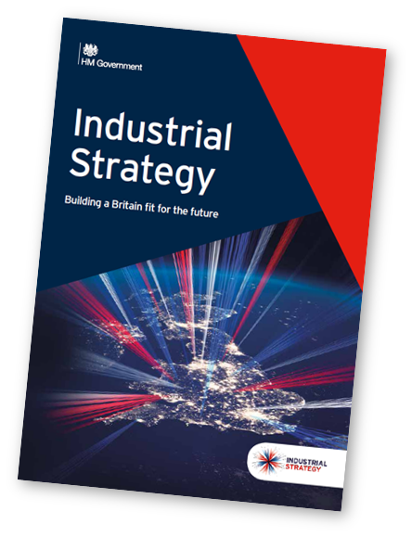
Moving to the Local Industrial Strategy
Industrial Strategy focus on ‘creating an economy which boosts productivity and earning power throughout the UK’
Commitment to Local Industrial Strategies, which will be very data driven
Expectations around evidence base production early 2019
Agreed LISs by March 2020
Shared Prosperity Fund live from April 2021 – wider focus than productivity…

