Slide 1
Supporting young people into employment
Jessica Stubbings - Education Development Manager
Standards Learning and Effectiveness Service jessica.stubbings@eastsussex.gov.uk
01323 463537

Slide 2
Introduction
Policy drivers
East Sussex County Council activities as an employer
Working in partnership to increase apprenticeships
Developing employability skills
Notes:
Part time education or training if they are self employer, employed or volunteering for 20 hours a week or more. 280 glh a year.
Full time education – no. of glhrs to be announced after consultation
Key role in preparing young people to participate: developing skills and achieving qualifications
Raising awareness of RPA with learners, parents/carers, governors and staff
Delivering new CE IAG duties to ensure young people have appropriate information, advice and guidance to progress

Slide 3
Policy Drivers
County Council’s Council Plan (2013/14):
Improving life chances of people with learning disabilities by supporting them to find and keep either voluntary or paid employment;
Improving the skills and qualifications of all children and adults to help drive economic regeneration;
Increasing the number of children that are in education, employment or training until they are 18 years old
Creating Futures Strategy: developing employability Skills 18-24 year olds
Notes:
East Sussex Strategic Partnership key tasks of:
Reduce barriers to employment and address worklessness.
Promote further and higher education and learning opportunities.
Invest in and promote skills development, especially in key sectors.
3

Slide 4
East Sussex Context:
76.9% of 16-18 year olds in learning
9.9% of 16-18 year olds that are not in education, employment or training
In 1999, around 12% of out of work benefit claimants were aged under 25 years, but by 2012/13 they accounted for 16% of all out of work benefits.
East Sussex apprenticeship starts declined for 16-18s and 19-24s in 2011/12 , -15% for 16-18 yr olds and -2% for 19-24 yr olds.
19-24s increased by 12% regionally and 12.6% nationally
Full year data for 2012/13 suggests that apprenticeship starts are continuing to decrease for 16-18 year olds
Notes:
In the year to April 2013, the employment rate in East Sussex was 70.9%
53 jobs for every 100 working age people who live in the county
East Sussex will need to reduce the number of people who are claiming out of work benefits – something that it has not really managed to achieve in over a decade. Despite the relative economic buoyancy of the ten years prior to the 2008/09 recession, there was virtually no change in the number of people claiming out of work benefits in the county. It was at a low of 29,540 in November 2001 and reached a peak of 31,840 in February 2006 and it now stands at 33,580.
Nationally 16-18s increased by 5.2% regionally, however decreased by 1.5% nationally
In East Sussex, the number of 16-24 year olds claiming Job
Seeker’s Allowance in October 2011 fell slightly, but rates remain high at
5.8%.
Academic Age16-18 (Y12-Y14) NEET %
Y12 NEET%
Y13 NEET%
Y14 NEET%
9.9%
5.3%
6.8%
17.4%
4

Slide 5
ESCC as an employer
Apprenticeship scheme
Currently 17 apprenticeships, 14 in Children Services (business admin. child care)and 3 in Highway Maintenance (civil engineering)
Encouraging schools to take on apprenticeships (business admin, ICT, teaching assistants)
‘Employability and Skills through Procurement’ policy
10 apprentices (fostering, construction, fleet maintenance, business admin)
Chartwells, school catering offering 10 work placements and 40 level 2 Apprenticeships in Professional Cookery
Pathway to Employment project funded by Job Centre Plus
50 work placements for 18-24 yr olds claiming job seekers allowance
First placements in Highways, ICT, Libraries, Children Services
‘Work Pairing’ a 6 month paid work placement scheme matching young people with employers’

Slide 6
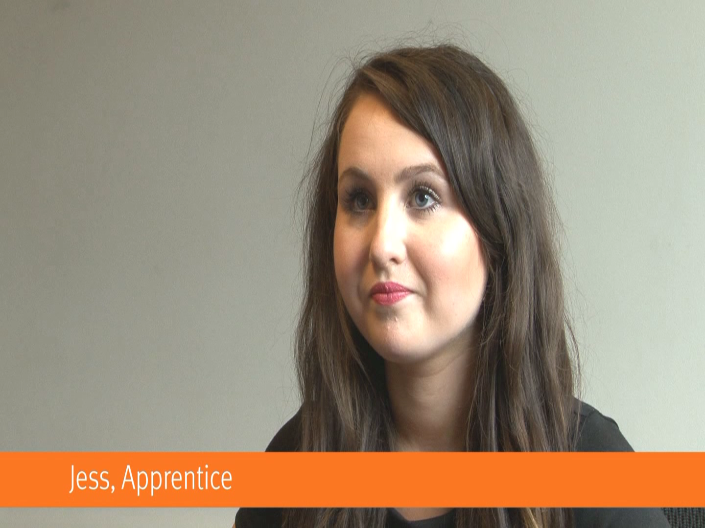

Slide 7
Working in partnership to increase apprenticeships
Apprenticeship in East Sussex Strategy Group
Identifying gaps and employer engagement
Supported apprenticeship training association in construction – TrAC
Working with South East Apprenticeship Company
Increasing awareness in schools
Grant from National Apprenticeship Service to raise awareness of apprenticeships and support young people to apply successfully
Notes:
Boroughs and Districts – Hastings ‘Grow Your Own’, Lewes – LEAP, Eastbourne ‘100 in a 100’

Slide 8


Developing Employability Skills
Work Experience Team provide a service to schools for 14-19 yr olds
28 schools/academies, providing placements for 2690 students
Bespoke placements for students with statement of educational needs
Licence to run Project Search – internship for learners with learning difficulties and/or disabilities with Sussex Downs College and local hospital, from Sept 2014 for 12 young people

Slide 9
Developing Employability Skills
Inspiring the Future campaign http://www.inspiringthefuture.org/
Work Pairing and L’EARN programmes
Employability Hubs – will offer a wide range of services and provision for unemployed adults in Eastbourne, ‘Hastings Works’ and rural Rother
Employability and Enterprise Skills: workshop provision for young adults, enterprise workshops/activities in schools and colleges
Development of the Council’s Employability and Skills Strategy will provide strategic framework

