Slide 1
Notes:
Gig Buddies is a project which enables people with learning disabilities and/or autism to be active in their communities and build friendships through shared interests.
This presentation gives an overview of how the project works and some of the context that surrounds the way the project is designed.

Slide 2
Notes:
Contact details for:
Paul Richards – Charity Director
Harri Oliver – Project Co-ordinator

Slide 3
Notes:
Imagine if you had to leave every night out at half past nine?
We know that going out and having an active social life is so important – it’s where you watch your favourite bands, meet your friends and feel connected.
Sadly for many people with learning disabilities the evening finishes around 9pm (if you’re lucky) due to staff working inflexible support shifts.
This is what drives our work as a charity

Slide 4
Notes:
Before we started Gig Buddies we did some research through Brighton University. We wanted to find out what was getting in the way of people with learning disabilities going out in the evening. These were:
They need support
They’re worried about keeping safe
Not having the confidence or motivation
Not having anyone to go with
No knowing what’s going on locally
Needing support with transport
We also found that people had an absolute desire to go out and be active in the evenings.

Slide 5
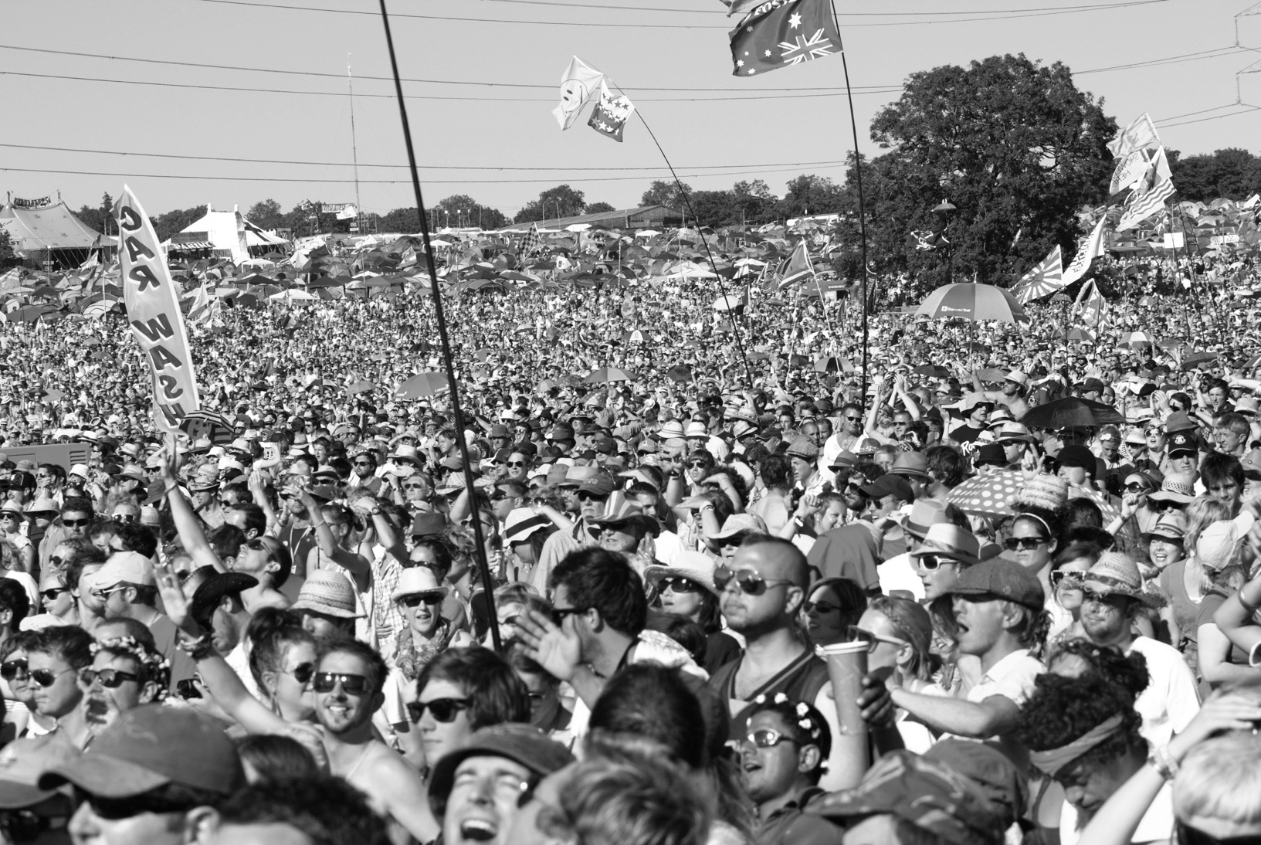
You can call them Al by NMK Photography is licensed under CC BY 2.0
Notes:
Loneliness in the UK.
This is a picture of the crowd at Glastonbury Festival. Imagine if that crowd were made up of people with learning disabilities.

Slide 6
Notes:
If it was about half of them wouldn’t be there.
This is just about not being able to ‘Stay Up Late’ – it’s about being able to get out at all!
These statistics came from the Learning Disability Coalition who surveyed people with learning disabilities, and their families, to find out about the impact of government funding cuts. (That was in 2010 and we’ve seen lots more cuts since then):
47% of people said they spent most time at home.
51% said they feel lonely.
64% said they don’t see their friends.
There are 1.4 million people with a learning disability in the UK.
There are 6.5 million people in the US and around 200 million worldwide.
Our own recent survey suggested that up to 72% of people with learning disabilities can’t get out in the evening.

Slide 7
Gig Buddies is a volunteer befriending project that seeks to build community capacity by enabling people with shared interests to connect, working in an assets based way.
The focus is promoting positive physical and mental well-being for the individuals involved, as well as collectively for the wider community.
Blah, blah, blah...
Notes:
This slide says what Gig Buddies is about (using local authority and Care Act jargon!)
But probably makes no sense to people who aren’t social care professionals.
We wouldn’t be able to engage with people with learning disabilities, and probably not potential volunteers either, if we used this kind of language.
(Although it has to be acknowledged that this slide tends to make ‘commissioning types’ quite excited as it says a lot of the things that are mentioned in the Care Act.

Slide 8
Gig Buddies is a volunteer befriending project that seeks to build community capacity by enabling people with shared interests to connect, working in an assets based way.
The focus is promoting positive physical and mental well-being for the individuals involved, as well as collectively for the wider community.
Blah, blah, blah...
Notes:
We simply call the project Gig Buddies.

Slide 9
Notes:
It’s all about linking up people with learning disabilities and/or autism with a volunteer so they can attend mainstream music and cultural events together as friends.
There are four main principles to Gig Buddies:
Community Life - It’s about meaningful participation in community life
Mainstream Culture - It’s about mainstream culture (not putting on separate events for people with learning disabilities)
Leadership by people with learning disabilities - People with learning disabilities are encouraged to take leadership in the project (both through the project oversight and their individual buddying relationships).
Friendship – It’s about friendship. You can’t pay to have friends in your life, and no paid for support service can replace the power of having somebody in your life who isn’t paid to be there for you.

Slide 10
Notes:
Exercise in Community Knitting
A little warm-up exercise for the group – asking people present what they like doing in their spare time, favourite bands, sports team etc.
We’ll be able to demonstrate some new potential connections in the room where people can chat over coffee about a similar interest they share.

Slide 11
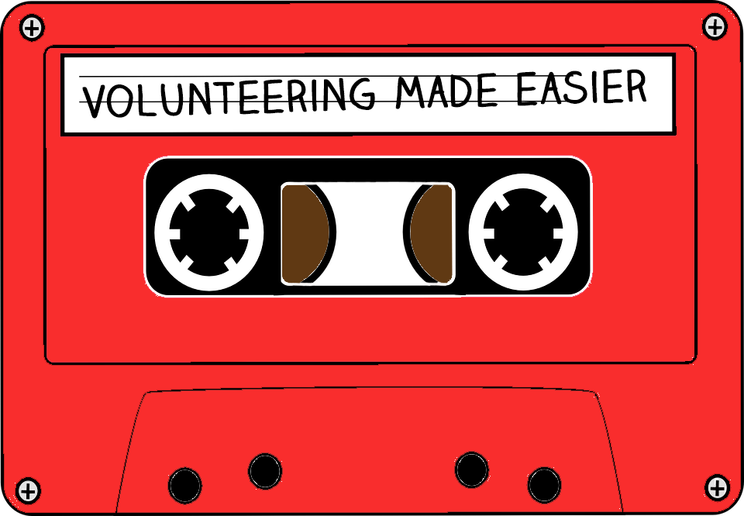
Notes:
One of the other main ideas behind Gig Buddies is trying to make volunteering as easy as possible.
We think there are three main reasons why people don’t volunteer:
1. They don’t want to
2. They don’t know what to do
3. They don’t have the time
We can’t do much about people who don’t want to, but Gig Buddies aims to solve the other two blocks.
Turning what you already enjoy doing in to a volunteering opportunity.
We try and make the act of volunteering as easy as possible.
And cut through as much of the ‘red tape’ as possible

Slide 12
Project outcomes
People with learning disabilities are less lonely and have more friends.
People with learning disabilities are empowered to make more choices about how they live their lives.
Communities become more inclusive.
Volunteers have a greater understanding of needs of people with learning disabilities
Notes:
These are the main outcomes that we work, and the difference that we hope our work will achieve.

Slide 13
Notes:
Friendship circle – part 1
This is what most people’s lives tend to look like. You’re at the centre and closest to you are your partner and your family.
Then there’s your close friends, the people you go to in a time of crisis, of just hang out with at the pub.
Then there’s people who have you have a shared interest with; they’re in your football team, go to your place of workship, sing in your choir, go to the same yoga class etc.
Then there’s people who are paid to be in your life; your doctor, your hairdresser, counsellor, plumber etc
And then those people who you know but not by name.

Slide 14
Notes:
Friendship circle 2
This is a generalisation of what life looks like for a lot of people with learning disabilities. There’s hardly anybody in their life who isn’t paid to be there, or isn't their family.
Gig Buddies volunteers are there to help create some connections in the missing circles. Both as a friend themselves but also in linking people with learning disabilities in to their communities, and communities of interest.

Slide 15
Evaluation (RiPFA)
86% see Buddy as a friend
76% more aware of other ways to spend spare time
79% go out more in the evenings (not just with their buddy)
48% said they did feel lonely at times
But 90% said having a Gig Buddy makes them feel less lonely
78% made new friends in addition to their Gig Buddy volunteer.
Notes:
Last year we had the project evaluated by Research in Practice for Adults.
These are the key findings from their report – showing that our work is having a real impact for socially isolated people.

Slide 16
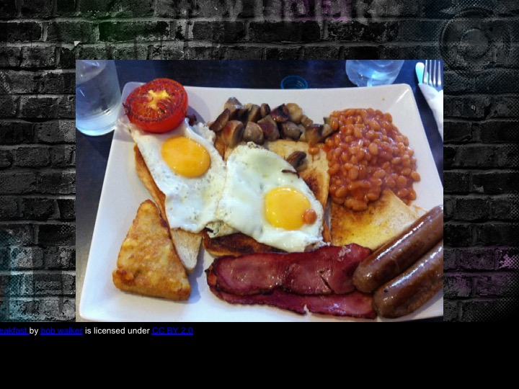
Bon Big Breakfast by bob walker is licensed under CC BY 2.0
Notes:
Studies have shown that loneliness and social isolation are a bigger killer than obesity.

Slide 17
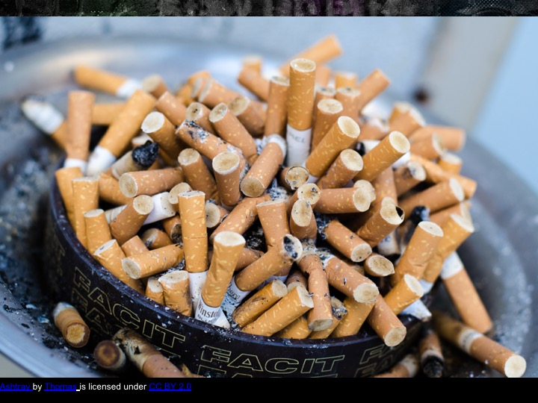
Ashtray by Thomas is licensed under CC BY 2.0
Notes:
And smoking 15 cigarettes a day.
So we ought to be risk assessing loneliness as a real risk to peoples’ health. It can be argued that ignoring this can be seen as a safeguarding issue (or at least should be).

Slide 18
Mother Teresa
Notes:
Mother Teresa summed it up with her quote:
“The most terrible poverty is loneliness, and the feeling of being unloved”

Slide 19
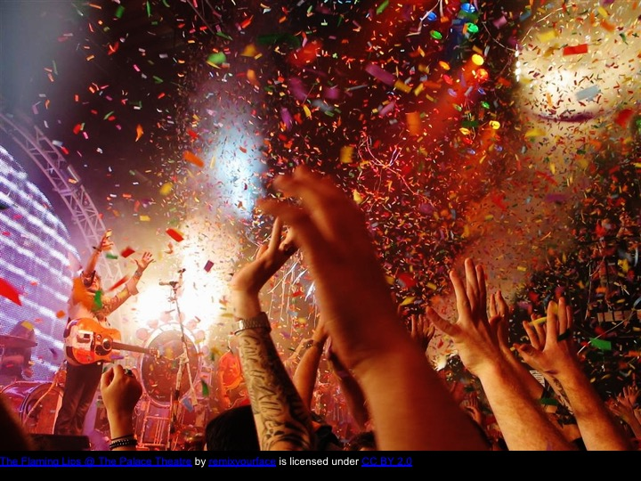
Notes:
Gigs are great if you love loud music, crowds, and flashing lights.
What if you don’t?
The important thing about Gig Buddies is that we find out what peoples’ ‘Gig’ is – that could be going to theatres, museums, church, sports matches – anything.

Slide 20
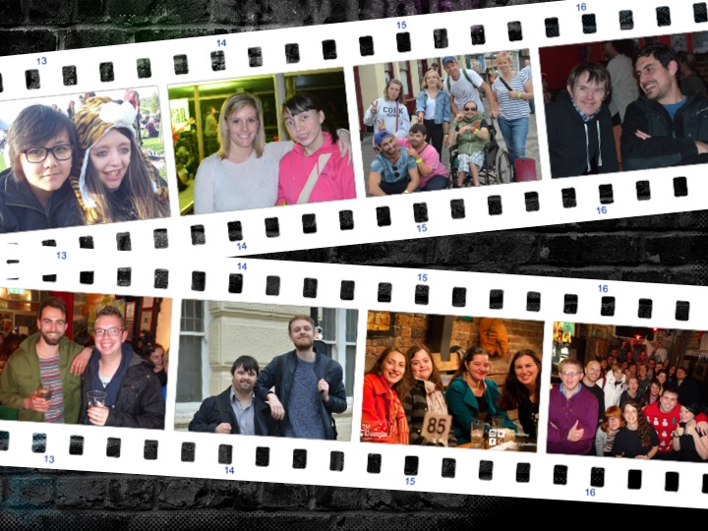
Notes:
Here’s some buddies in action
A wide range of people doing a wide range of different things, regularly.
We’ve got around 100 pairs of buddies going out to mainstream events across Sussex every month.

Slide 21
Notes:
This was an interview between Harri and Dean, a man with a learning disability who lives in Eastbourne.

Slide 22
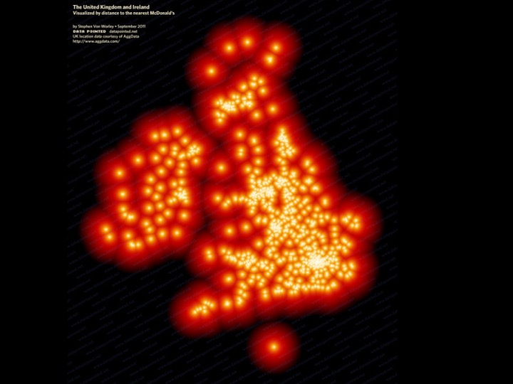
Notes:
Such has been the interest in our work though that we’ve been asked to support other organisations in the UK to replicate our work.
This is a rather depressing image. It’s a heat-map showing you how far you are away from a McDonalds outlet anywhere in the UK.
But it does make us think that maybe one day we could create a much more positive version showing Gig Buddies style projects across the UK! (and maybe in more places overseas too)

Slide 23
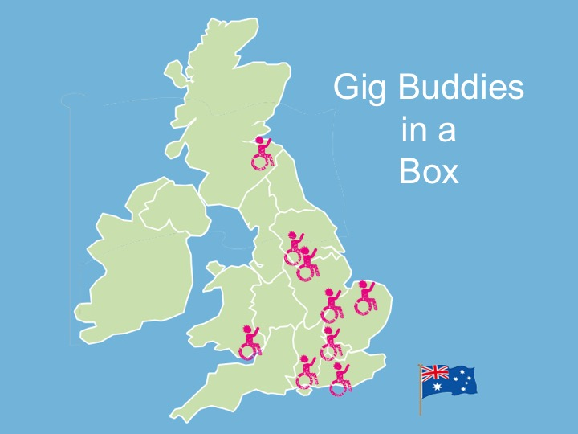
Notes:
So far we’ve worked with organisations in various parts of the UK, and in Australia and there are more planned.

Slide 24
Notes:
A photo that sums Gig Buddies up. Two buddies in a pub, eating pizza, chatting about their shared love of Heavy Metal and planning what gig to go to next.

Slide 25
Notes:
Maybe the approach to our work can be summed up succinctly be a great punk. John Lydon.
It’s just about loving everybody properly.

Slide 26
@stayuplateuk
info@stayuplate.org
www.stayuplate.org
‘promoting full and active social lives for people with learning disabilities’
Notes:
And if you want to be a volunteer yourselves please do drop us a line.

